Slide 1
SNMP Server
(CENTOS)
Group Members
Gulfam Haider BSIT-F17-LC-095
Arslan Chaudhary BSIT-F17-LC-080

Slide 2
SNMP Server (Introduction)
It is stands for Simple Network Management Protocol.
Simple Network Management Protocol ﴾SNMP﴿ is a popular protocol for network management. It is used for collecting information from, and configuring, network devices, such as servers, printers, hubs, switches, and routers on an Internet Protocol (IP) network.
SNMP is an application–layer protocol defined by the Internet Architecture Board (IAB) in RFC1157 for exchanging management information between network devices. It is a part of Transmission Control Protocol⁄Internet Protocol (TCP⁄IP) protocol suite

Slide 3
SNMP Server (Introduction)
SNMP Manager It is a centralized system used to monitor network. It is also known as Network Management Station (NMS)
Managed device A managed device or the network element is a part of the network that requires some form of monitoring and management e.g. routers, switches, servers, workstations, printers, UPSs, etc.
SNMP Agent It is a software management software module installed on a managed device. Managed devices can be network devices like PC, router, switches, servers etc.

Slide 4
SNMP agent’s key functions
Collects management information about its local environment
Stores and retrieves management information as defined in the MIB.
Signals an event to the manager.
Management Information Base MIB consists of information of resources that are to be managed. These information is organized hierarchically. It consists of objects instances which are essentially variables.
MIB object Identifier (OID) MIB The MIBs comprises of managed objects identified by the name Object Identifier (Object ID or OID).Each Identifier is unique and denotes specific characteristics of a managed device. Every Object ID is organized hierarchically in MIB. The MIB hierarchy can be represented in a tree structure with individual variable identifier. A typical object ID will be a dotted list of integers. For example, the OID in RFC1213 for "sysDescr" is .1.3.6.1.2.1.1.1

Slide 5
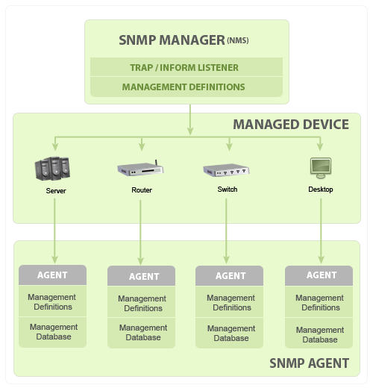
Basic SNMP working Diagram

Slide 6

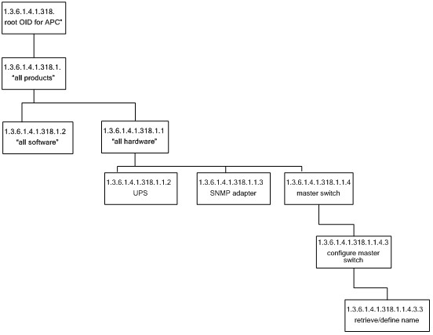
MIB structure

Slide 7
SNMP basic commands
GET: The GET operation is a request sent by the manager to the managed device. It is performed to retrieve one or more values from the managed device.
GET NEXT: This operation is similar to the GET. The significant difference is that the GET NEXT operation retrieves the value of the next OID in the MIB tree.
GET BULK: The GETBULK operation is used to retrieve voluminous data from large MIB table.
SET: This operation is used by the managers to modify or assign the value of the Managed device.
TRAPS: Unlike the above commands which are initiated from the SNMP Manager, TRAPS are initiated by the Agents. It is a signal to the SNMP Manager by the Agent on the occurrence of an event.
INFORM: This command is similar to the TRAP initiated by the Agent, additionally INFORM includes confirmation from the SNMP manager on receiving the message.
RESPONSE: It is the command used to carry back the value(s) or signal of actions directed by the SNMP Manager.

Slide 8
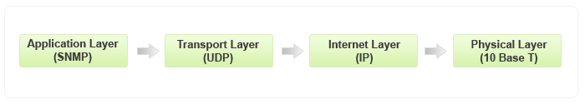
Typical SNMP communication

Slide 9
SNMP Server (Working)
First You have to Check Connection Between two device and reachability over the IP protocol. that we are using in the current in our network.
You have to configure SNMP Community Setting over the device for receive SNMP trap and add IP address of SNMP server and SNMP Community Name their so device can send Traps over the same.
Configure the same Version of SNMP on the both device. If you are not doing the same then, device can be communicating but not Receive the SNMP Trap Over the network.
Do the configuration with the correct information on every setup then you get updates in a better Way.

Slide 10
SNMP Server (Installing in Centos)
Commands:
yum install net-snmp //installing snmp server
cp /etc/snmp/snmpd.conf /etc/snmp/snmpd.conf.bak //making the backup file
cd /etc/snmp/ //going to snmp directory
ls //checking the files list
vi snmpd.conf //open the configuration file
netstat -aunt //check the port status
service snmpd start //start the snmp
systemctl status snmpd //check the status of snmp
yum install net-snmp-utils //package (optional)
snmpwalk -v 1 -c gulfamarslan localhost //check the monitoring

Slide 11
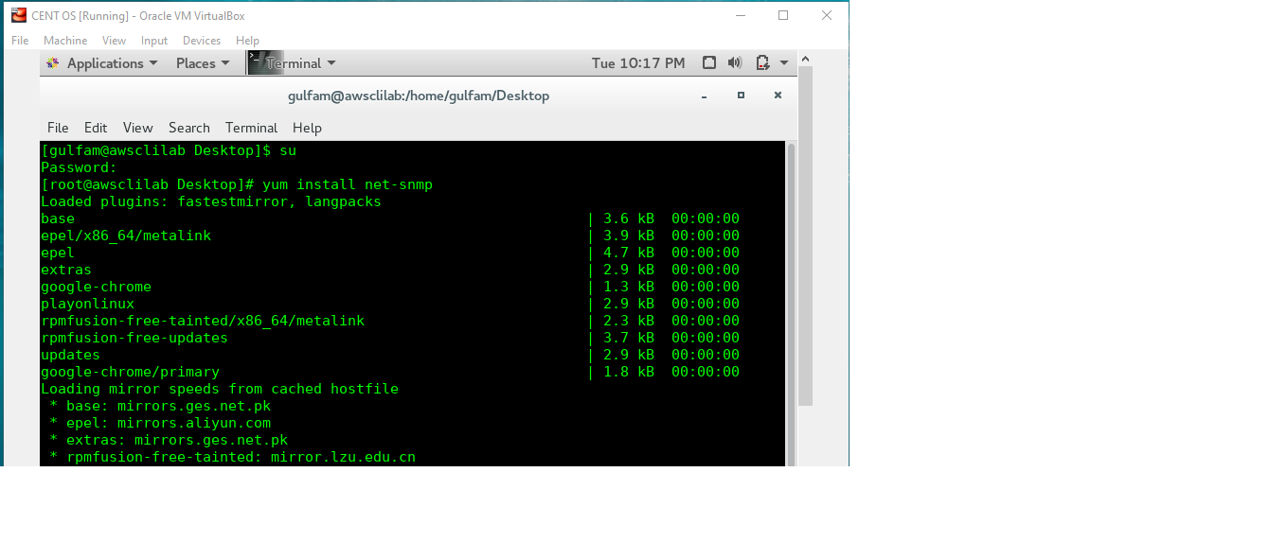
Installing in SNMP Server

Slide 12
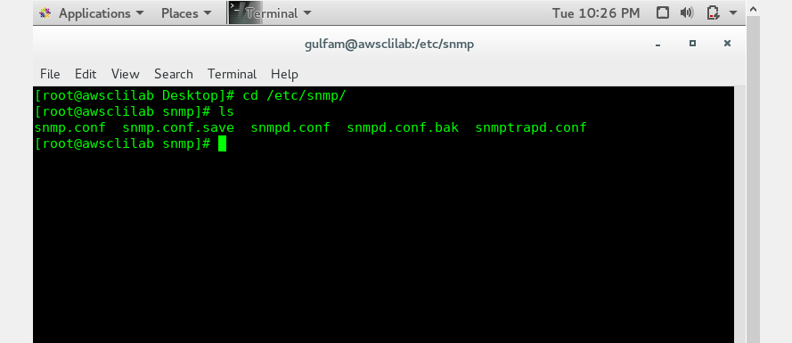
Check the files list:

Slide 13
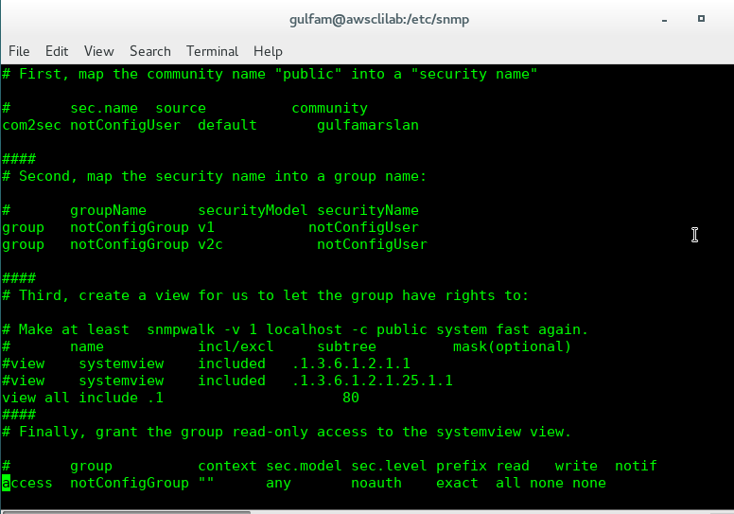
Make the Configuration file:

Slide 14
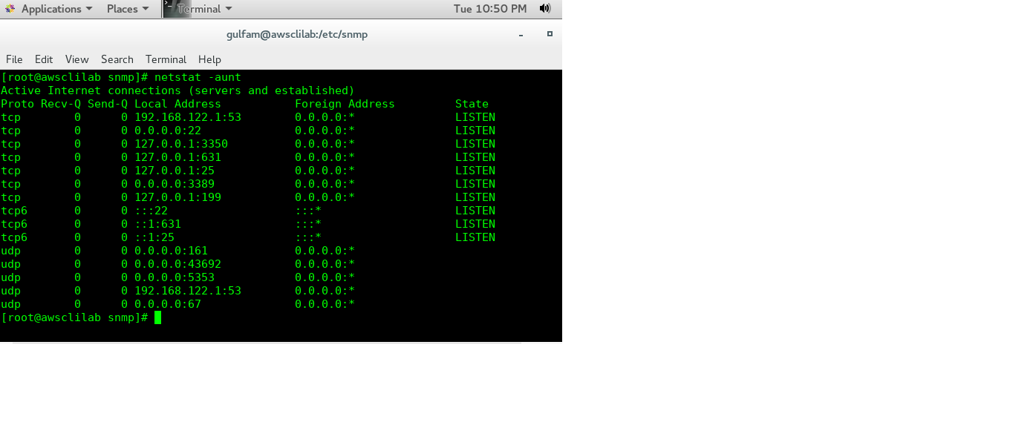
Check the Port Status

Slide 15
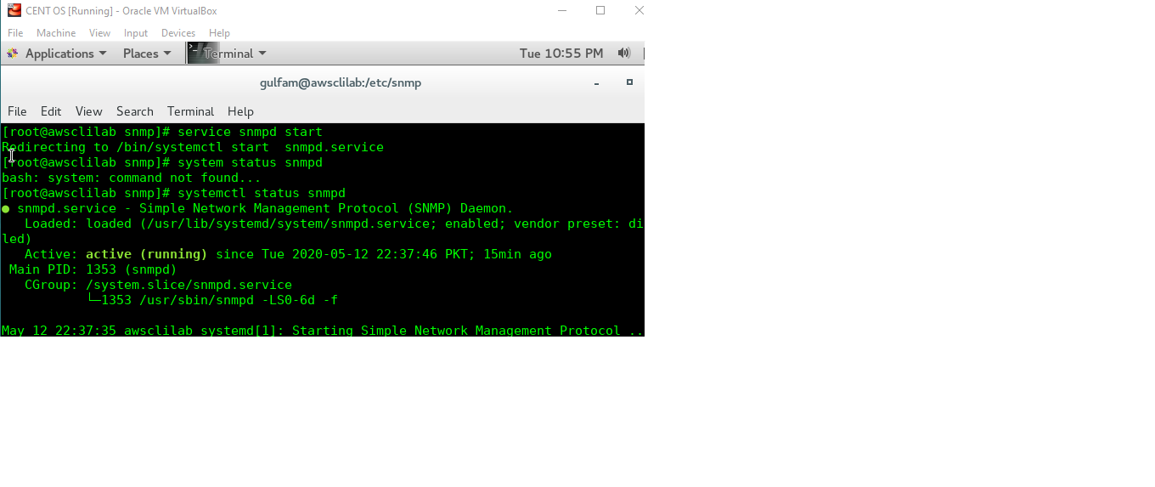
Status of SNMP Server

